Slide 1
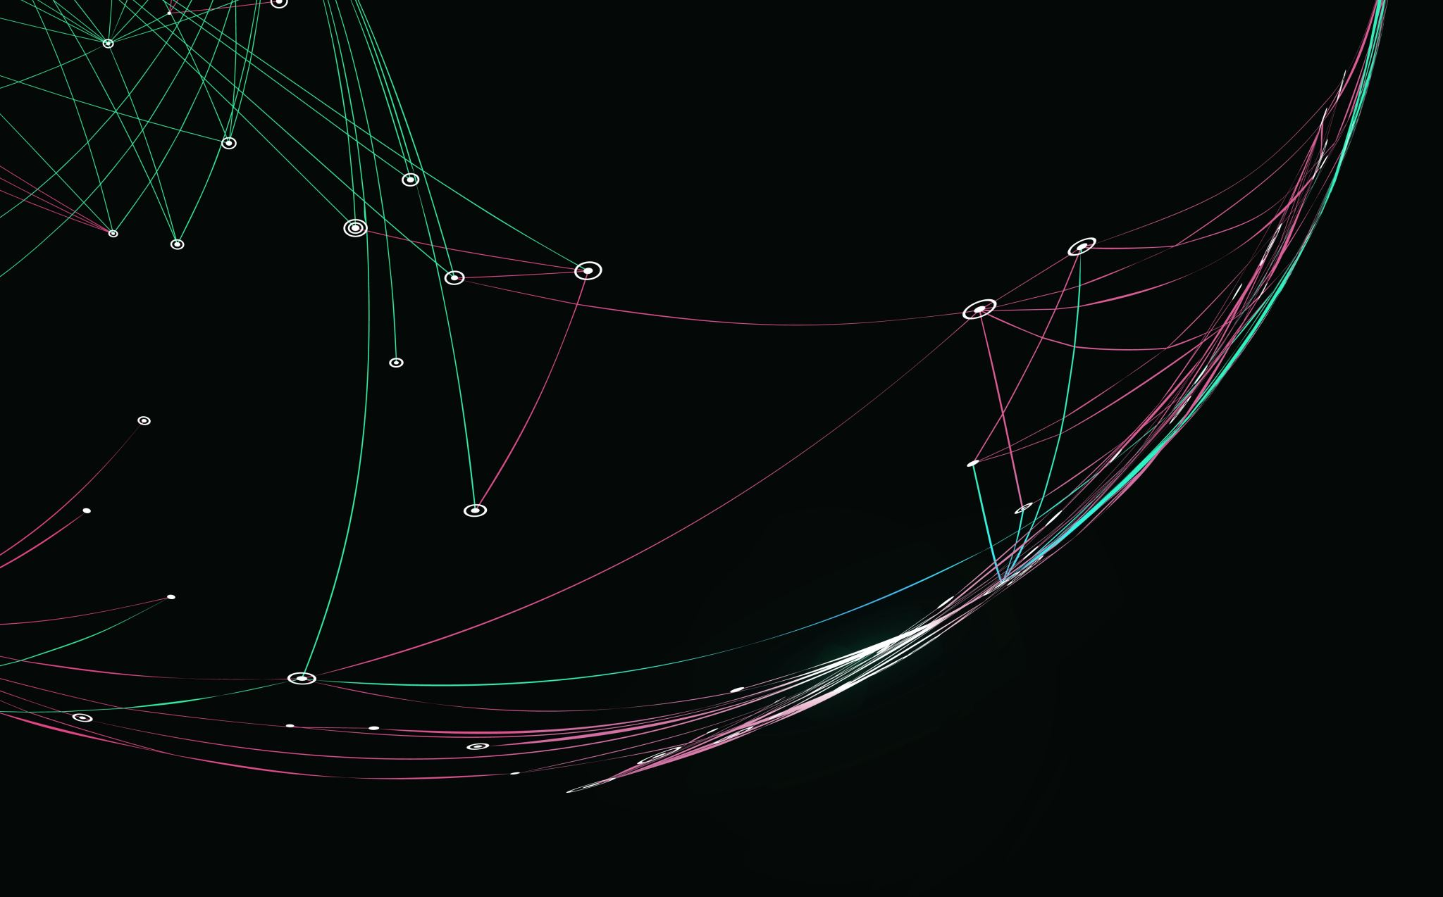
Nick’s Titanic Spaceship Analysis
A project done in R Studio

Slide 2
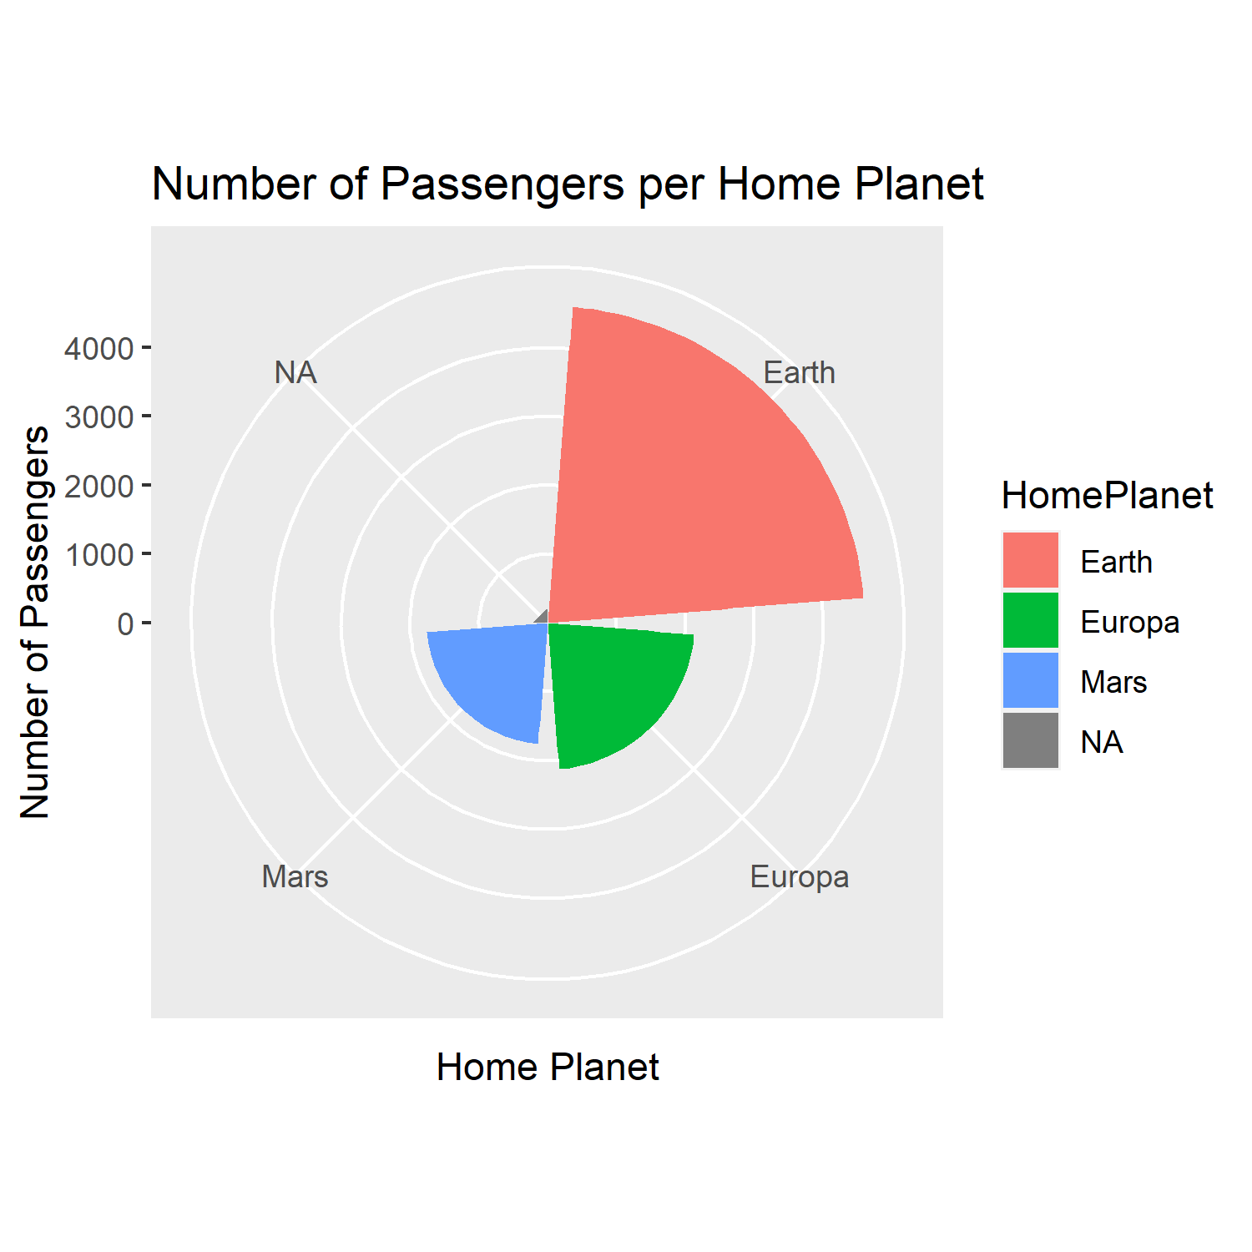
Passengers per Home Planet
Home Planet | Passengers
Earth | 4602
Europa | 2131
Mars | 1759
NA | 201
The first thing I did in my analysis was check to see how many passengers were from each home planet.
There were more passengers from planet Earth than all of the other home planets combined. Earth had more than twice as many passengers as the second most popular home planet, Europa.

Slide 3
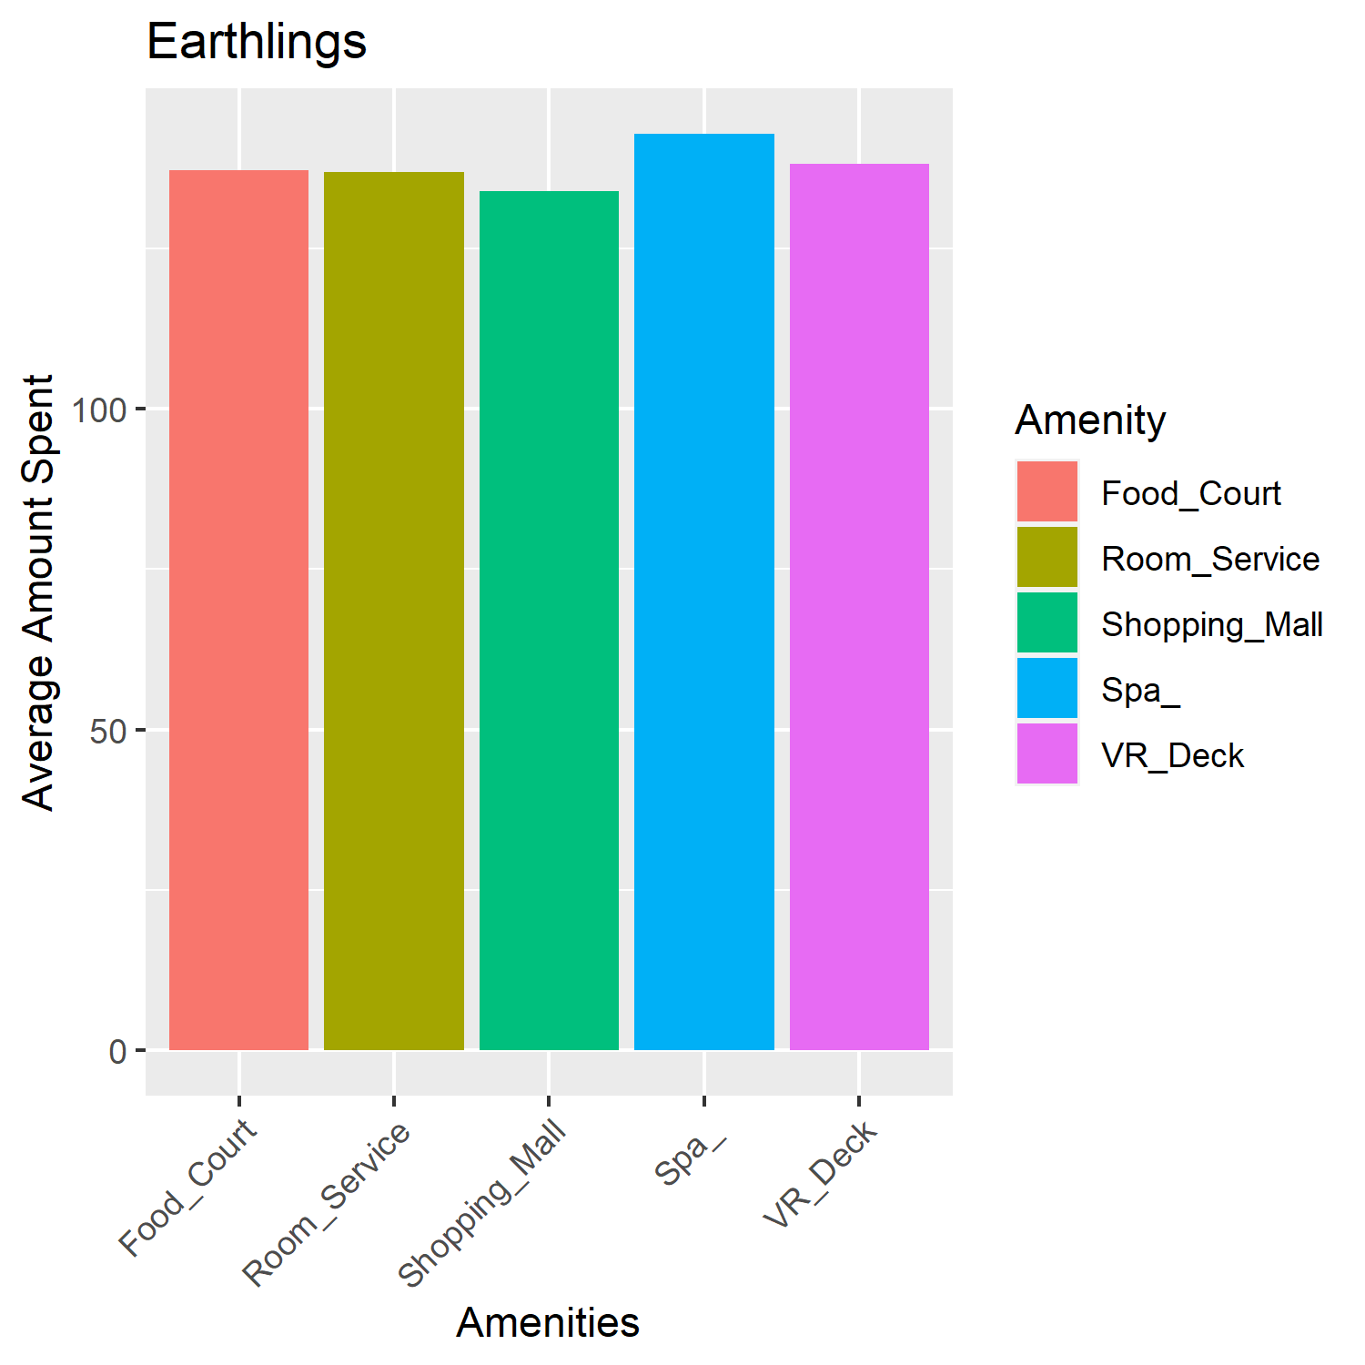
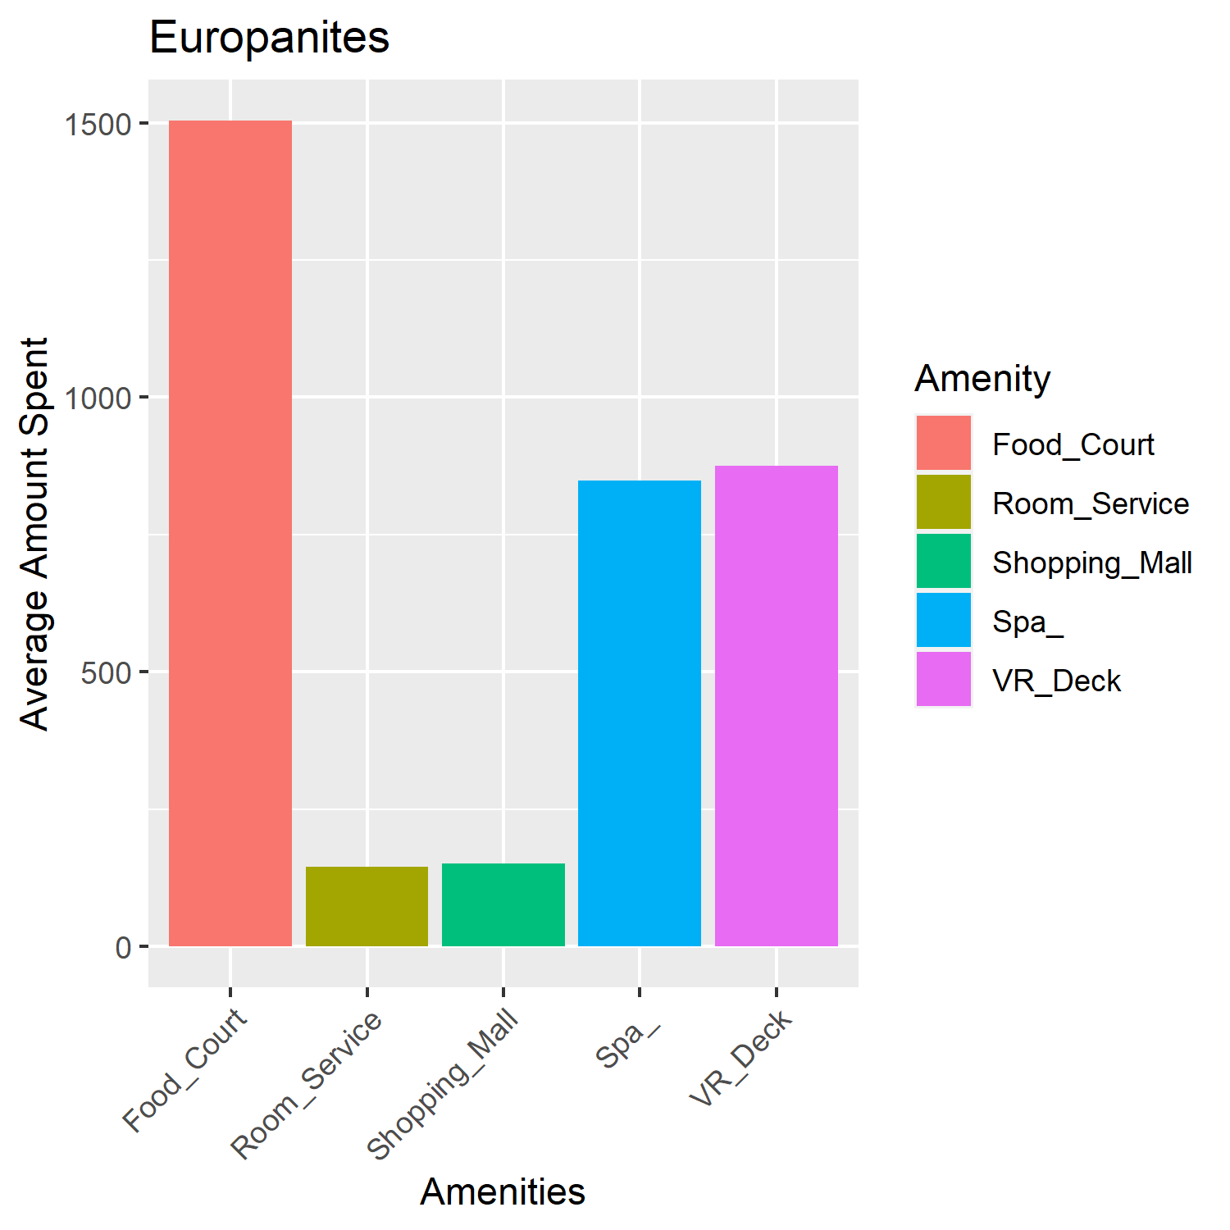
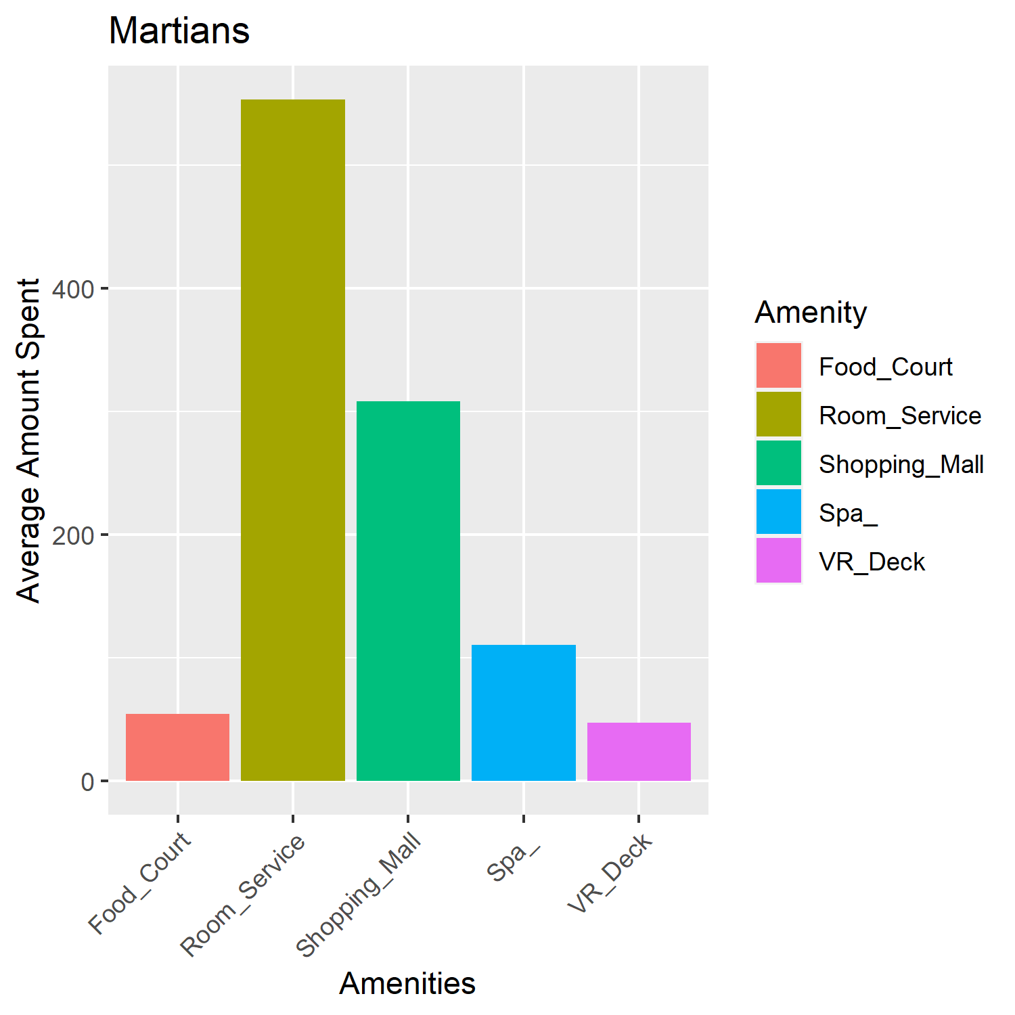
Spending per Home Planet
Although Earthlings make up over half of the passengers onboard, their average spending is quite low compared to the other Home Planets. Europanites spend over 5x as much on amenities as Earthlings!
Europanites love spending money at the food court. They also enjoy the spa and the VR deck. Martians really love food service and Earthlings can be found spending their money evenly on all of the amenities.
*These graphs are not at the same scale
Home Planet | Average | Total
Earth | $ 688.44 | $ 2,823,306.00
Europa | $ 3,552.75 | $ 6,828,385.00
Mars | $ 1,074.12 | $ 1,696,039.00

Slide 4
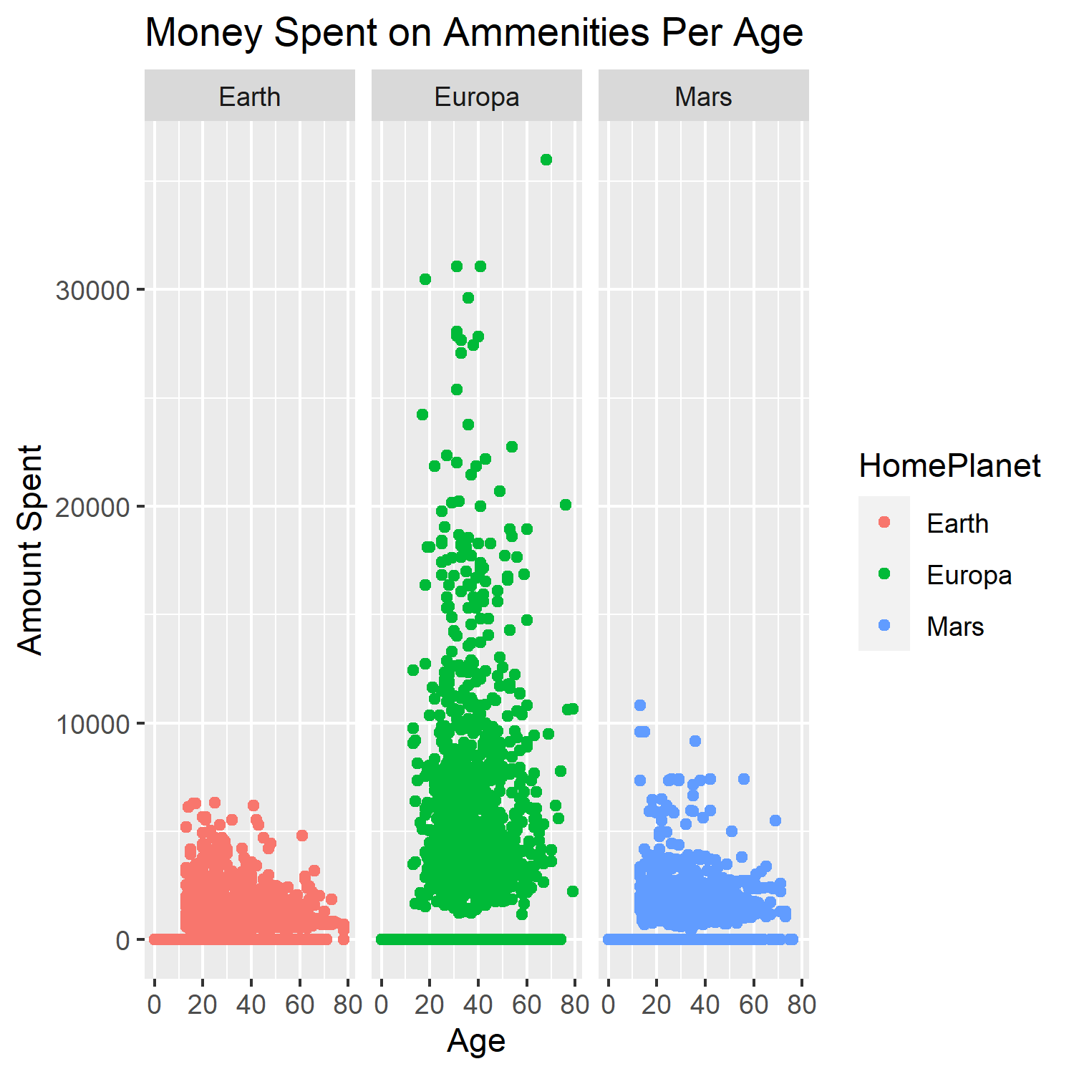
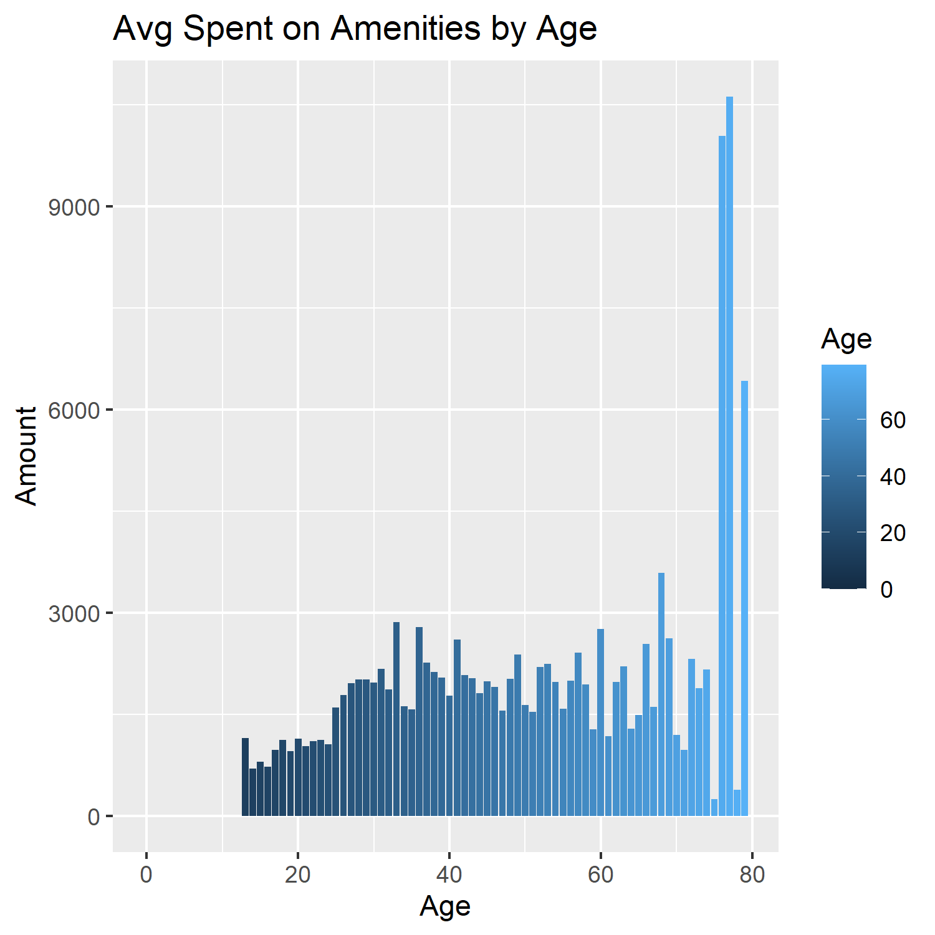
Spending per Age
It turns out that age can play a factor in a passenger’s spending. For Earthlings and Martians, passengers in their 20’s are spending more than other age groups. But, with Europanites, spending seems more even for most ages with some very high spending outliers in the older age range.

